Slide 1
Agenda
Calculated Fields
What they can do?
Field operations vs aggregations
Table calculations
Types of table calculations
Usage
Level of Detail (LoD)
Expressions

Slide 2
Calculated Fields: What they can do?
Arithmetic Expressions
Logical Expressions
Spatial Expressions
Function calling
Aggregations
+, -, *, /
IF … THEN …, CASE … WHEN ..
AREA, DISTANCE
SCRIPT_INT, SCRIPT_BOOL
SUM, AVG, COUNT, …

Slide 3
Calculated Fields: Field operations vs Aggregations
Calculated Field - Margin:
= Profit / Sales
Calculated Field - Margin:
= SUM(Profit) / SUM(Sales)
Cat1 | Cat2 | Sales | Profit | Margin
A | A | 5 | 2 | 40%
B | A | 10 | 3 | 30%
C | B | 15 | 4 | 26%
D | B | 20 | 5 | 25%
Cat1 | Cat2 | Sales | Profit
A | A | 5 | 2
B | A | 10 | 3
C | B | 15 | 4
D | B | 20 | 5
Margin
40%
30%
26%
25%
Sales | Profit | Margin
50 | 14 | 30%
View
Sales | Profit | Margin
50 | 14 | 28%
View

Slide 4
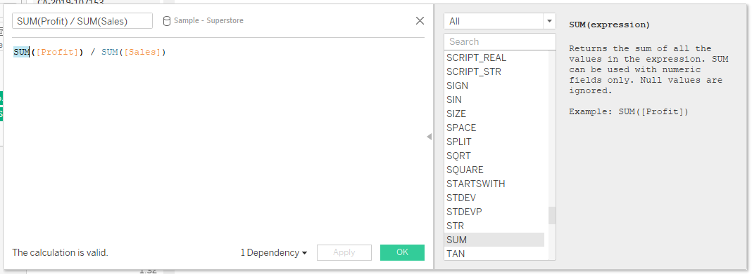
Calculated Fields: Syntax
Expression
Functions
Explanation
Errors

Slide 5
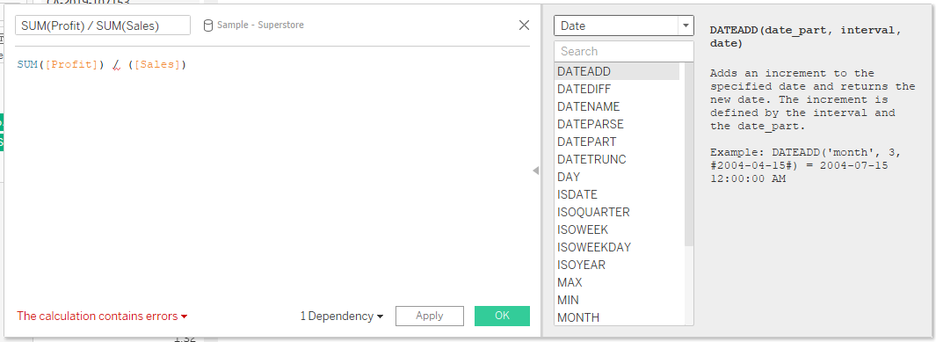
Calculated Fields: Syntax
Expression
Functions
Explanation
Errors

Slide 6
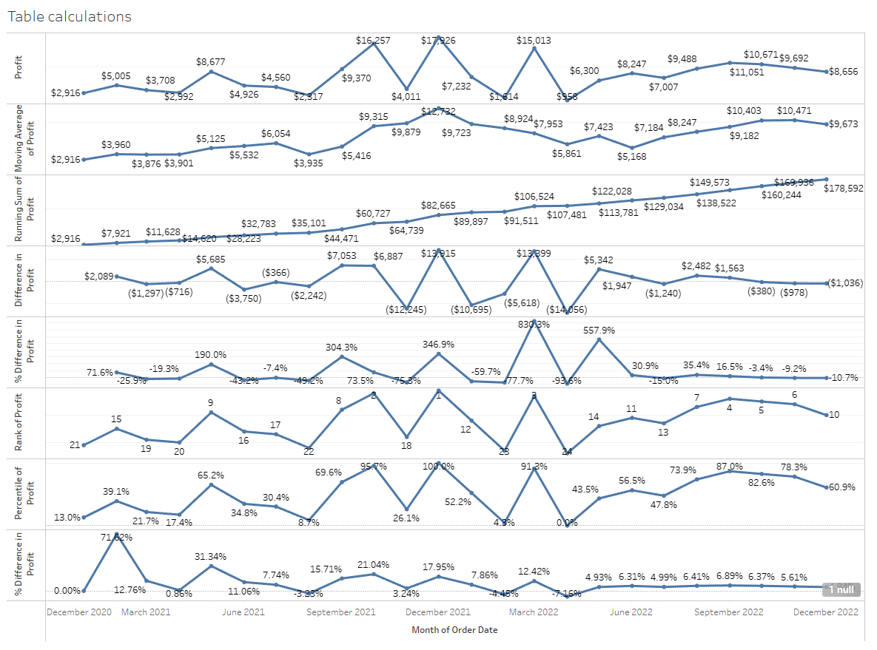
Table calculations: Types of table calculations

Slide 8
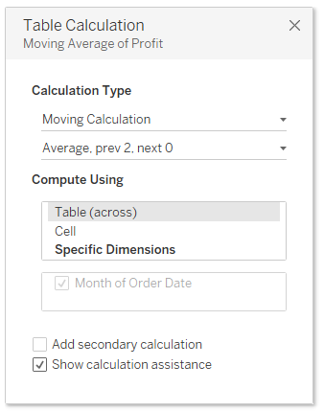
Table calculations: Usage
Configuration
Execution row

Slide 9
Level of Detail (LoD): Expressions
Calculate an expression within or outside a certain granularity
Key Functions:
INCLUDE – Always include the defined dimension and the view dimensions
EXCLUDE – Never use the defined dimension for calculation
FIXED – Always use defined dimension for calculation
Syntax: „ { [LoD] [Dimension]: [AGG]([Measure]) } „
Example: „ { EXCLUDE [Category]: SUM(Profit)} “

Slide 10
Level of Detail: INCLUDE
INCLUDE – Always include the defined dimension and the view dimensions
Example: Sales per Store in an aggregated view
Notes:
find the total sales per city, but you're also interested in how each Store contributes to that.
LOD Expression: { INCLUDE [Store] : SUM([Sales]) }
Calculation Steps:
For each row, include the Store in the aggregation along with whatever else is in the view (e.g., City).
Results:
For Store A in San Diego: 5 (Latte) + 3 (Espresso) = 8
For Store B in San Diego: 6 (Latte) = 6
For Store C in San Francisco: 7 (Latte) + 4 (Espresso) = 11
For Store D in San Francisco: 5 (Latte) = 5

Slide 11
Level of Detail: EXCLUDE
EXCLUDE – Never use the defined dimension for calculation
Example: Profit share per product

Slide 12
Level of Detail: FIXED
FIXED – Always use defined dimension for calculation
Example: Share of revenue of products per city
Notes:
find out the total sales for each city, regardless of the Store or Product.
LOD Expression: { FIXED [City] : SUM([Sales]) }
Calculation Steps:
Group the data by City.
Sum the Sales for each group.
Results:
San Diego: 5 + 3 + 6 = 14
San Francisco: 7 + 4 + 5 = 16
So regardless of the Store and Product, each row in the visualization will show 14 for San Diego and 16 for San Francisco when using this FIXED LOD expression.
INCLUDE Example: Total Sales Per City, Considering Store
Here you want to find the total sales per city, but you're also interested in how each Store contributes to that.
LOD Expression: { INCLUDE [Store] : SUM([Sales]) }

Slide 13
Assignment: Product Performance Dashboard
Create an in-depth analytical dashboard that focuses on the performance of products, primarily measured by sales and profit, across various dimensions such as Category, Region, and Time.
Key Metrics
Total Sales: Aggregated sales figures for various dimensions
Total Profit: Aggregated profit figures for various dimensions
Average Sales per Order: Average value generated from each order
Average Profit per Category: Average profit within each product category
Moving Sales Average: The trend of sales across different time periods
Percent of Total Sales: Proportion of sales attributed to each category.
Notes:
Objective:
Create a Tableau dashboard that analyzes sales performance, focusing on the relationship between Categories, Regions, and other dimensions like Sales and Profit. Use both LOD expressions and table calculations to derive insights.
Steps:
Data Understanding
Open the Sample - Superstore dataset in Tableau.
Familiarize yourself with the dataset by going through columns like Category, Region, Sales, Profit, and others.
Basic Visualization
Create a bar chart showing total sales by Category.
Create another bar chart showing total sales by Region.
LOD Expressions
FIXED: Calculate the average sales per order for each Category. Use {FIXED [Category] : AVG([Sales])}. Add this to your dashboard.
INCLUDE: Create a calculated field to find the total sales for each Category within each Region. Use { INCLUDE [Region]: SUM([Sales]) }. Add this to your dashboard as well.
EXCLUDE: Create a calculated field to find the average profit for each Category, excluding the Region dimension. Use { EXCLUDE [Region]: AVG([Profit]) }. Add this to the dashboard too.
Table Calculations
Create a moving average of Sales across different quarters for each Category.
Calculate a Percent of Total Sales for each Category and represent it in a pie chart.
Advanced Analysis
Create a scatter plot showing Profit vs Sales for each Category. Use a table calculation to add a trend line.
Use an LOD expression to add a reference line showing the overall average Sales irrespective of Category or Region.
Dashboard Creation
Combine all these visualizations into a single dashboard. Use filters to make it interactive.
Documentation
Add tooltips and annotations to make sure the dashboard is self-explanatory.
Expected Outcome:
By the end of this task, you should have a comprehensive dashboard analyzing sales performance with a focus on Categories and Regions. You will utilize both LOD expressions and table calculations to dive deeper into the data.
Total Sales
Calculation: Sum of the Sales column
Tableau Expression: SUM([Sales])
Total Profit
Calculation: Sum of the Profit column
Tableau Expression: SUM([Profit])
Average Sales per Order
Calculation: Total Sales divided by the number of Orders for each category
LOD Expression: { FIXED [Category]: AVG([Sales]) }
Average Profit per Category
Calculation: Sum of the Profit divided by the number of products within each Category, excluding the Region dimension
LOD Expression: { EXCLUDE [Region]: AVG([Profit]) }
Moving Sales Average
Calculation: The average of Sales over a specified time range (e.g., over four quarters)
Tableau Table Calculation: WINDOW_AVG(SUM([Sales]), -3, 0)
Percent of Total Sales
Calculation: Sales for each Category divided by Total Sales, then multiplied by 100
Tableau Table Calculation: (SUM([Sales]) / TOTAL(SUM([Sales]))) * 100

